Slide 1
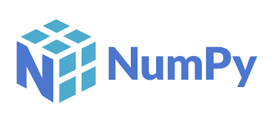

Numpy library
DATA ANALYTICS BOOTCAMP | IRONHACK

Slide 2



Python Libraries
In python, libraries are containers with have lots of useful new types of variables and functions/methods developed by third parties. This allow us to save time avoiding the need of coding them.
A good analogy can be to think libraries like bookshelves and the functions as books. If we need a book, we need to go to the corresponding bookshelf and then pick the book or books we want.
What is a Python library?
00

Slide 3
Python Libraries
There are three ways of load them:
import library_name
import library_name as alias
from library_name import function
How we can use a library in Python?
00

Slide 4
Python Libraries
import library_name
We use this option when we may want to use all the functions included in the library
WARNING!!!
The problem with this approach is that if the library has one function which has the same name as another we defined, one function will replace the previous one.
Thus, we will lose the possibility to use both functions (function overload)
00

Slide 5
Python Libraries
import library_name as alias
This is the most common way to prevent the previous problem. Here "alias" is another shorter name that we want to use to call our library.
The the alias name is not relevant, we can use any other name we want. However, the coding community has some non written conventions of which alias to use for each library.
Usually, everybody uses the same aliases for the same libraries to prevent confusion.
To use a function contained inside a library recently loaded we use:
Ex:
alias.function1
00

Slide 6
Python Libraries
from library_name import function
This option is used when we only need any specific function from the library.
Another possibility is to call several functions from the library. Then the only thing we need to do is to provide a list of functions separated by comma.
Ex:
from library import function1, function2,...
00

Slide 7
Numpy: what is used for?
Numpy (short for Numerical Python) is a library used to speedup numeric computing
It includes support for multi-dimensional lists and matrices along with a variety of mathematical functions to apply to them.
To use the library use the following library :
import numpy as np
np.sum()
np.mean()
np.__version__ (to check your current version of the library)
00

Slide 8
Why is it important?
Numpy is used by many other libraries that will be covered later during the bootcamp as:
Pandas
Matplotlib
Sklearn
Official web page
00

Slide 9
Numpy arrays
Numpy come with its own variable types, different from python’s built in data types.
The basic variables in Numpy are arrays, which can be used to represent tabular data. (You can think of arrays as lists of lists, where all the elements of a list are of the same type (typically numeric since the reason you use Numpy is to do numeric computing)
The size of an array is the total number of elements in every list
The shape of an array is the size of the array along each dimension (e.g. number of rows and number of columns for a two-dimensional array)
a = np.random.random((10,4)) ( here we are using the function ‘random’ from np.random)
>>> print(a)
>>> print(a.shape)
>>> print(a.size)
Numpy arrays are mutable
00

Slide 10
Numpy additional types of variables
Variable types
We can change the type of a variable using the function np.astype( new_type )
Some new types are:
np.bool_ (boolean)
np.short
np.int_ (integer)
np.double (float)
np.float32
np.float64
00

Slide 11
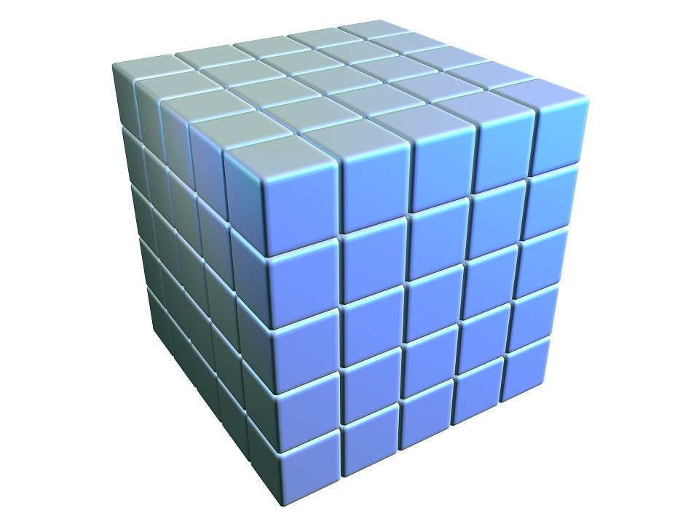
Numpy arrays: extracting data
# First row of array c
>>>print(c[0])
# First row, second column
>>>print(c[0,1])
# First row, second column, all the slides (:)
>>>print(c[0,1,:])
Numpy arrays also accept ranges to access values
>>>print(c[0:6,:,0:]
0
1
00

Slide 12
Numpy arrays are more efficient than lists
Lists are super flexible as they can contain elements of different types.
To allow this, each item in the list must contain its own type info, reference count, and other information.
If all variables are of the same type, much of this information is redundant: it’s more efficient to store data in a numpy fixed-type array.
If you need to store heterogeneous variables use lists, otherwise use numpy arrays.
00

Slide 13
Casting lists into numpy arrays
We can cast python lists into numpy arrays as long as all the elements of the list are of the same type. Otherwise numpy will try to cast all the elements to the same type if he can.
lst_lst = [[1,2,3],[4,5,6],[7,8,9]]
d = np.array(lst_lst)
print(d)
[[1 2 3] [4 5 6] [7 8 9]]
How can I access value 5?
00

Slide 14
Math functions
# Sum of all elements in array a
>>> print(np.sum(a))
# Sum of each row in matrix a
>>> print(np.sum(a, axis=1))
# Subtract elements of x from elements of y
>>> print(np.subtract(y, x))
Why not using simply the function sum()? Because np.sum() is optimized for speed in numpy arrays.
00

Slide 15
Numpy cheat sheet
Cheat Sheet
00

Slide 16


